Slide 1
Chapter 11
Data Techniques

Slide 2
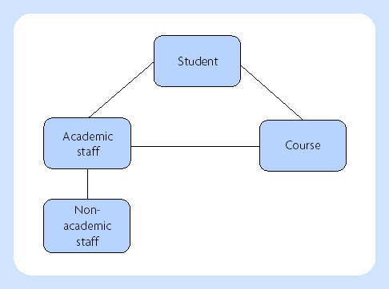
Entity modelling – a first approach

Slide 3
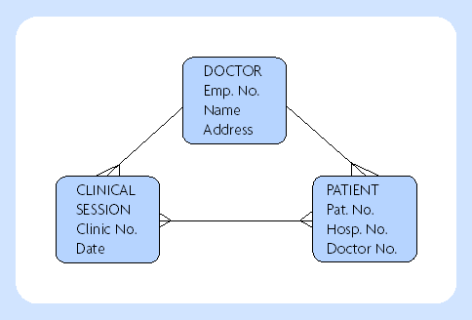
Entity modelling

Slide 4
Terminology
Entity
Attribute
Key attribute
Relationship
Cardinality

Slide 5

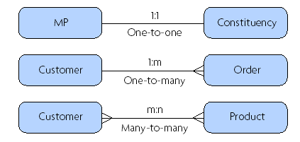
Cardinality of the relationship

Slide 6
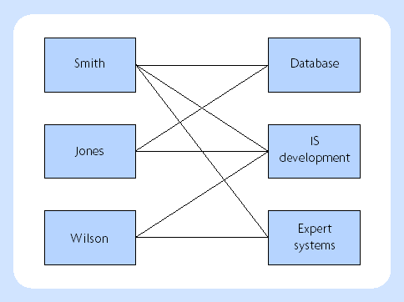
Many-to-many relationship

Slide 7
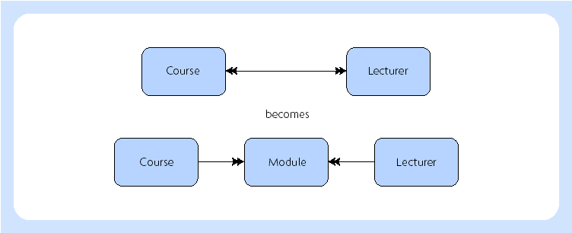
Many-to-many relationship converted to one-to-many

Slide 8
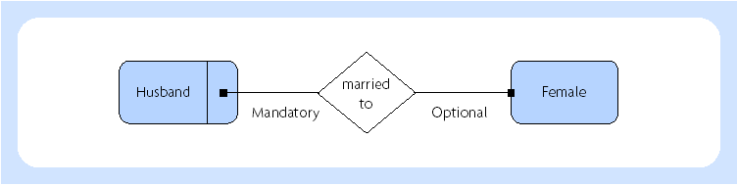
Mandatory and optional relationships

Slide 9
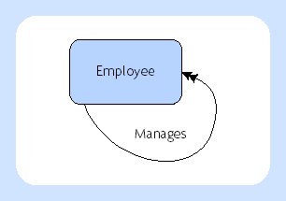
Involuted relationships

Slide 10
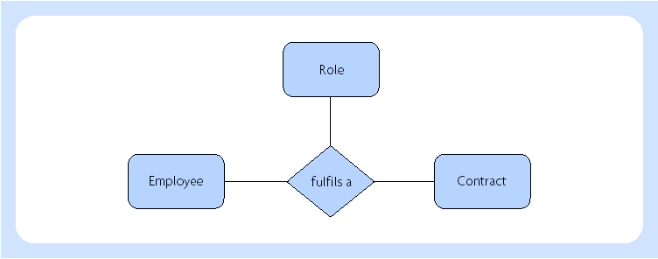
Ternary relationship

Slide 11
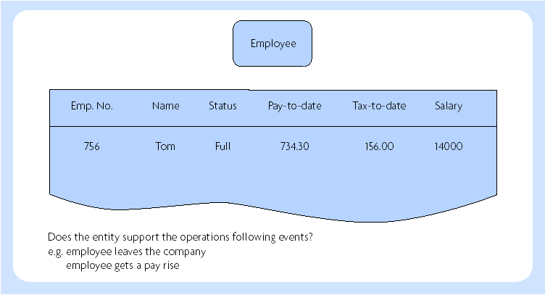
Event-driven analysis

Slide 12
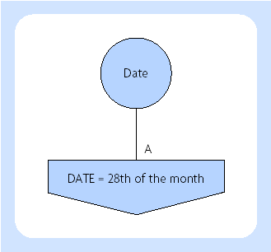
Synchronization of an operation

Slide 13
Data analysis
1. Define the area for analysis
2. Define the entities and the relationships
between them
3. Establish the key attribute(s) for each entity
4. Complete each entity with all the attributes
5. Normalize all the entities
6. Ensure all events and operations are
supported by the model

Slide 14
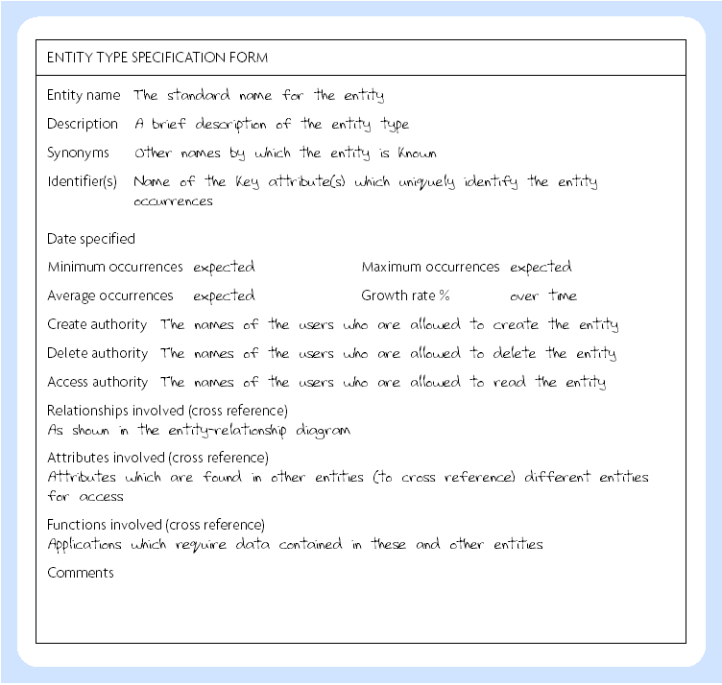
Entity documentation

Slide 15
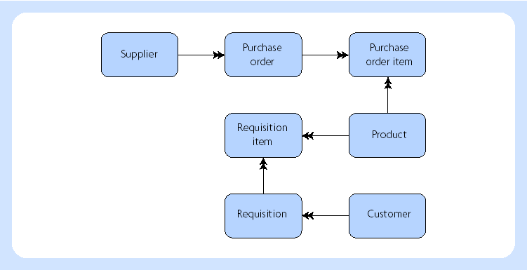
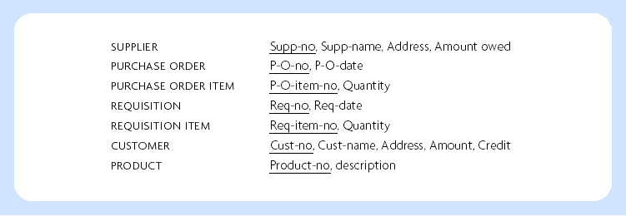
Entities with attributes

Slide 16
Terminology of relational model
Relation
Tuple
Domain
Composite key
Candidate key
Primary key
Foreign key

Slide 17
Normalisation
First normal form – ensure that all the attributes are atomic (i.e. in the smallest possible components). This means that there is only one possible value for each attribute and not a set of values. This is often expressed as the fact that relations must not contain repeating groups.
Second normal form – ensure that all non-key attributes are functionally dependent on (give facts about) all the key. If this is not the case, split off into a separate relation those attributes that are dependent on only part of the key together with the key.
Third normal form – Ensure that all non-key attributes are functionally independent of each other. If this is not the case, create new relations which do not show any non-key dependence.

Slide 18
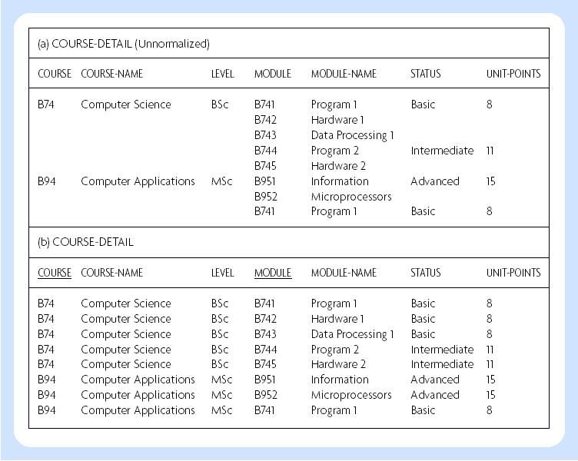
1st normal form

Slide 19
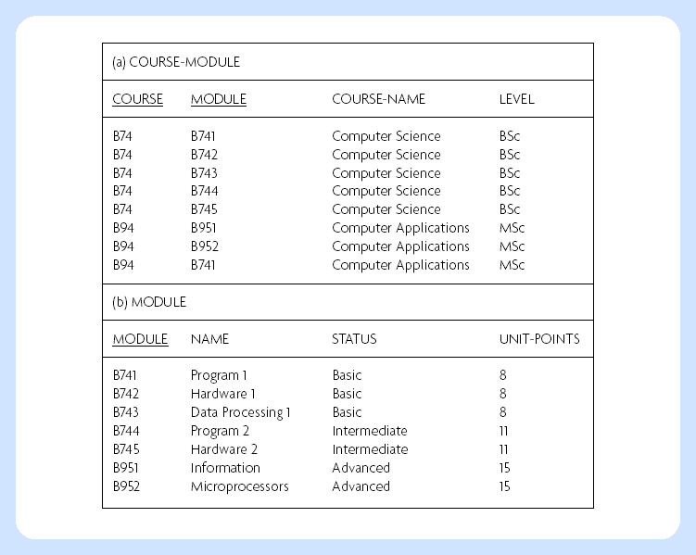
First step toward 2nd normal form

Slide 20
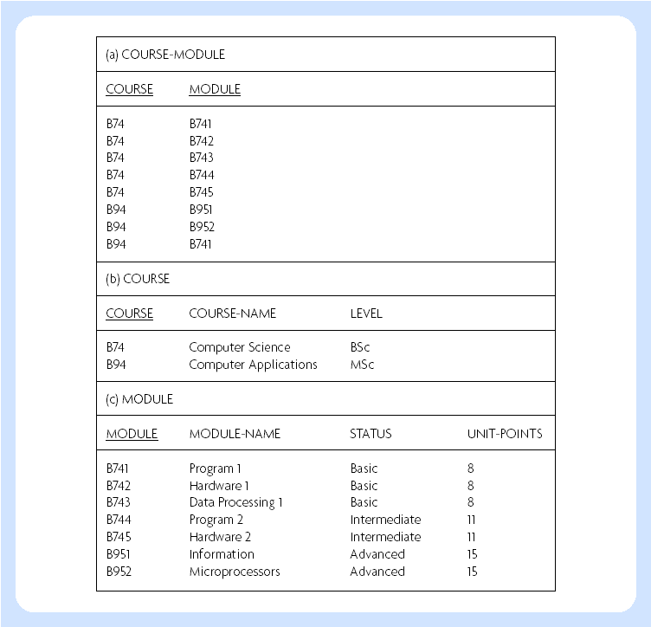
2nd normal form

Slide 21
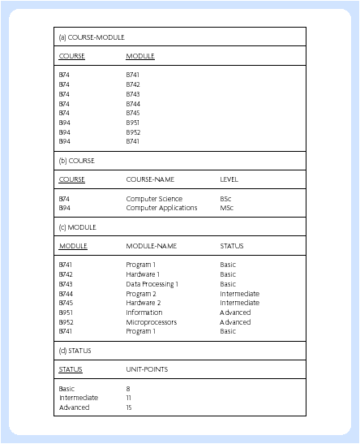
3rd normal form

Slide 22
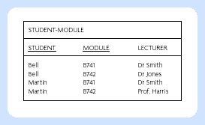
Relation in TNF but not BCNF

Slide 23
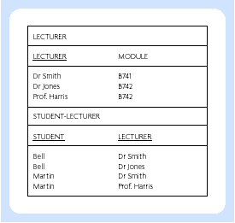
BCNF

Slide 24
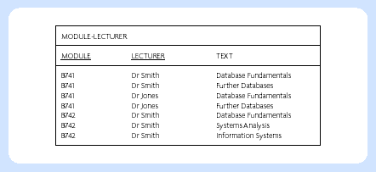
BCNF but not 4th normal form

Slide 25
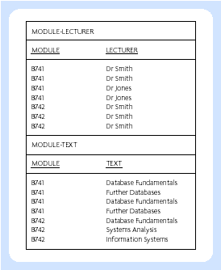
4th normal form

